Slide 1

PROJECT EVALUATION
Problem Statement:
Identifying patterns in the data collected at a Shopping Mall based on customer spend score & demographics using K Means Clustering
TEAM TURING
Ayush Balpande
Kshitij Chaube
Shantanu Sonulkar
Vedant Farde
June 2023

Slide 2
Contents:
Introduction​
Data Science Modeling
Application Program Interface(API)
​Front-end
Back-end
​Business Use

Slide 3

Introduction
By using this project:
We empower organizations to target customers who have higher chance of buying particular products.
This helps to further drive effectiveness within organization. By closing the loop and leveraging agile frameworks, we can help business grow organically and foster a consumer-first mindset.

Slide 4
Connected with SQL
Register Page
ML MODEL
API
Login Page
Customers Details
Customers Database

Slide 5





ML Workflow
Data
PREPARATION
DAta preprocessing
DATA VISUALIZATION
MODEL
CREATION
VISUALIZING THE RESULTS
Exploratory data analysis (EDA)
Checking null values and Catagorical values
Label Encoding
Feature selection
Outlier detection
Normalization or Scaling
Creating different plots to visualize the data and better access the need of preprocessing
Finding values of k and creating a clustering model fitted with the data
Validating the predictions of the model by crating visualization.

Slide 6
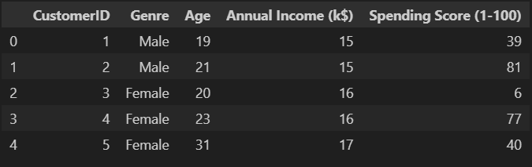
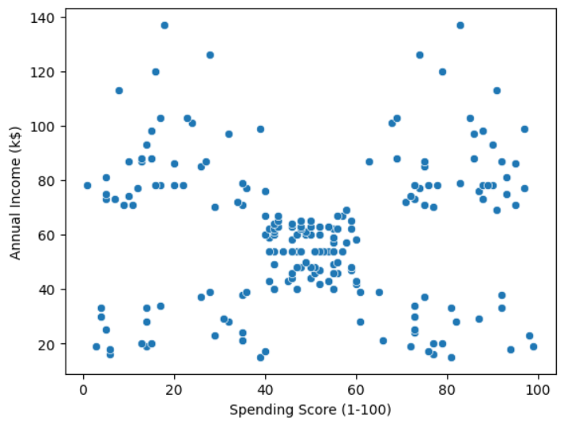
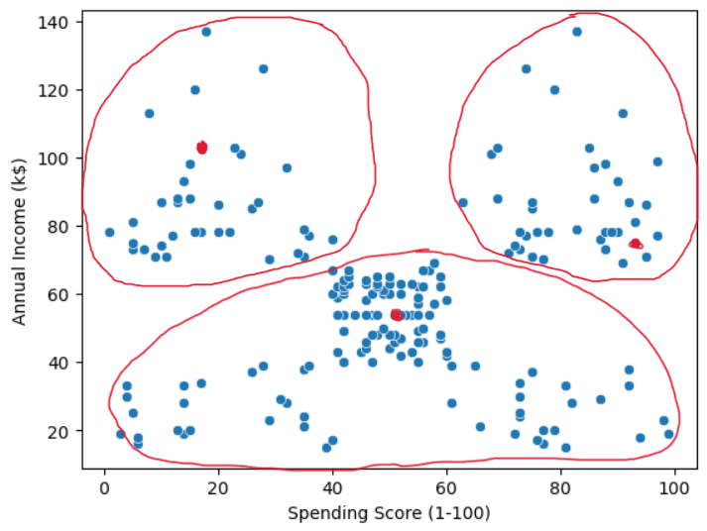
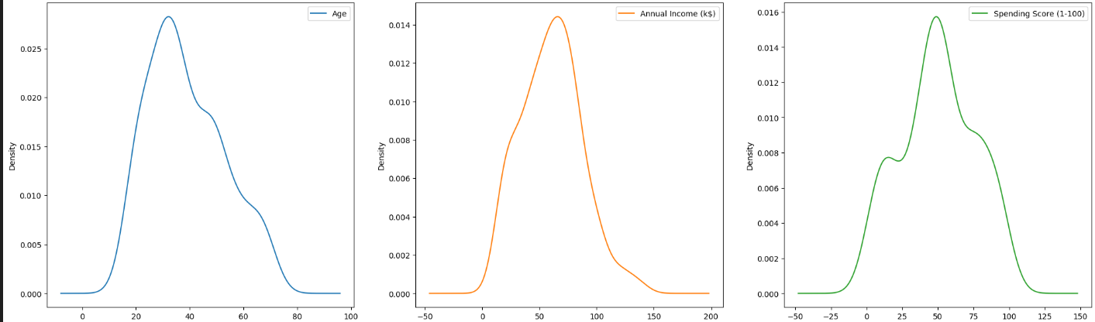
Dataset and Model Used
Dataset
K-means Clustering

Slide 7
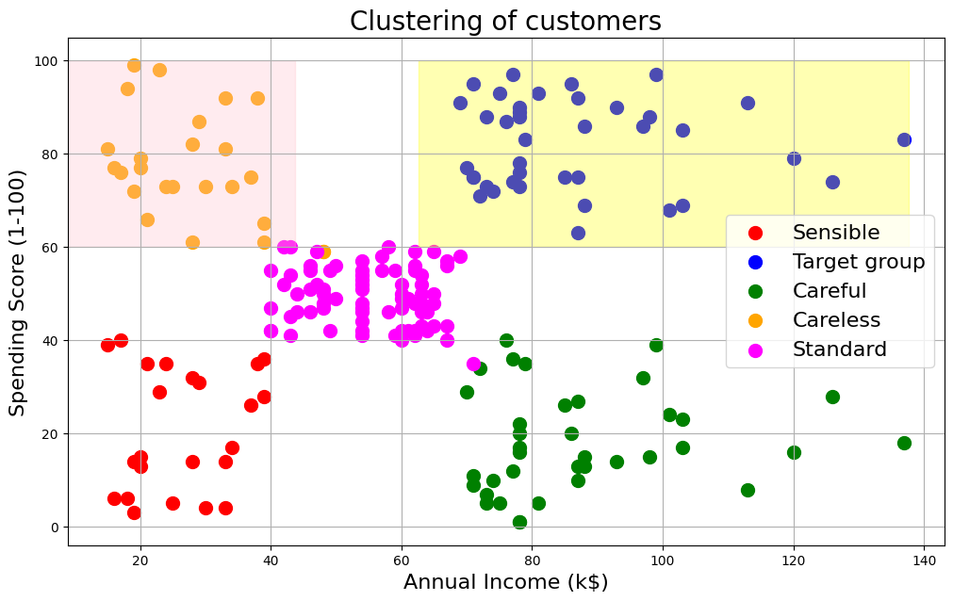

MODEL PERFORMANCE

Slide 8
Application Programming Interface
What is Application Programming Interface (API)?
2. Why are we using API in this project ?
To create communication interface
To send user input data to the model
To separate front-end and back-end logic
To serve as a bridge
3.Purpose of our API code
Utilized trained ML model
Takes inputs(Age, Annual income, Spending score)
Predicts output

Slide 9
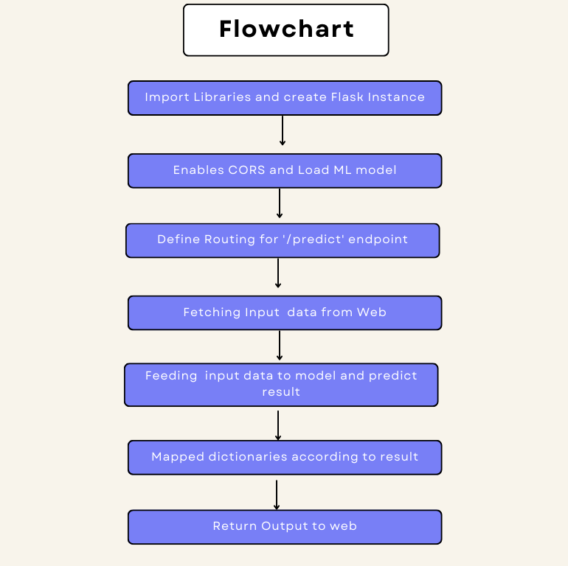
API INTEGRATION

Slide 10
API INTEGRATION
1.Importing Libraries and create flask instance:-
2 Enables CORS and Load Ml model
Pickel.load()
3 Defining routes
Post request to "/predict" endpoint
def predict()
4 Fetching input data
Fetch the data in json format through request.json
Segregating and typecasting the input data as our model takes only integer values
Check condition for Spending score
Flask
Request
jsonify
render_Template
Pickel
CORS

Slide 11
API INTEGRATION
5.Feeding input data into model
Predict()
6 Mapping of dictionaries
Category dictionary represent the category of customer
labels dictionary represent the attributes of customer
Stores result in prediction dictionary
7 Return Output
Convert it into json
8 Run Flask Application
Run in debug mode
Port =9000

Slide 12
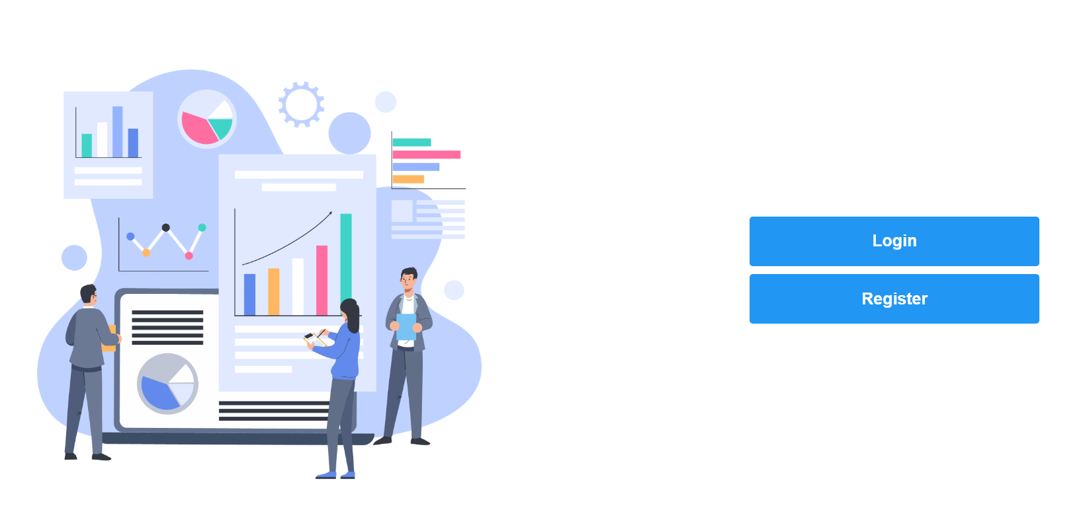
Home Page

Slide 13
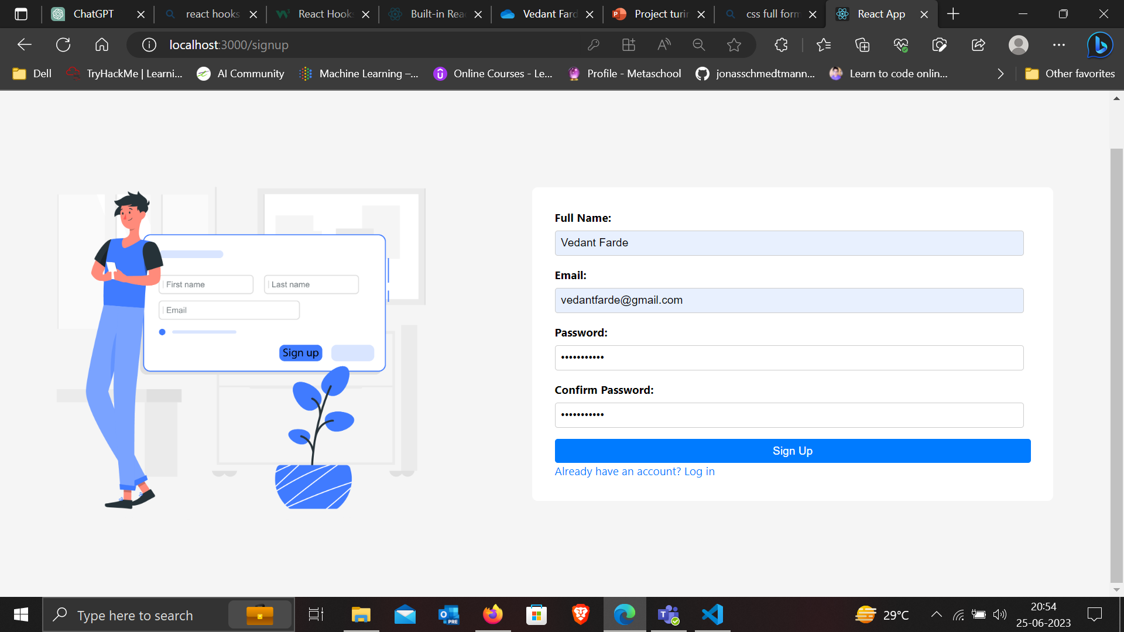
Sign Up

Slide 14
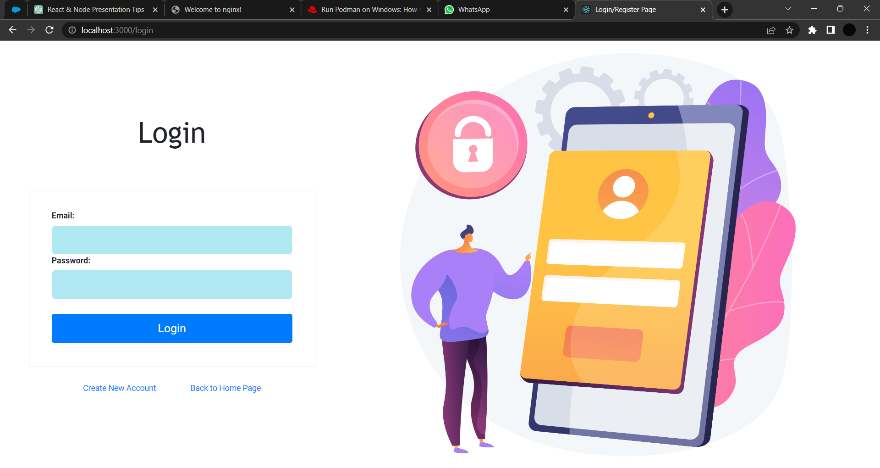
Login Page

Slide 15
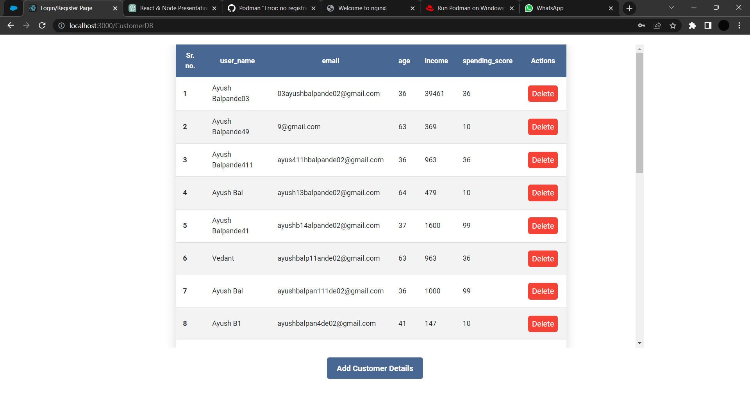
Database For Admin

Slide 16
JWT (JSON Web Tokens): Simplifying Web Application Security"
JWT is an open standard for securely transmitting information between parties as a JSON object. It is commonly used in web applications and APIs to authenticate and authorize users.
Emphasize the importance of secure communication and data integrity in web applications.
Highlight the role of JWT in providing a secure and efficient way to transmit information.
Mention the increasing popularity of JWT as a token-based authentication mechanism.
State the purpose of the presentation: To provide an overview of JWT, its structure, and its common use cases in web applications and APIs.

Slide 17
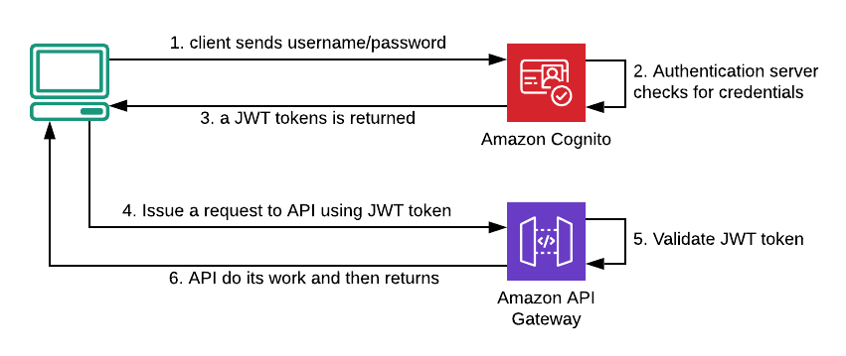
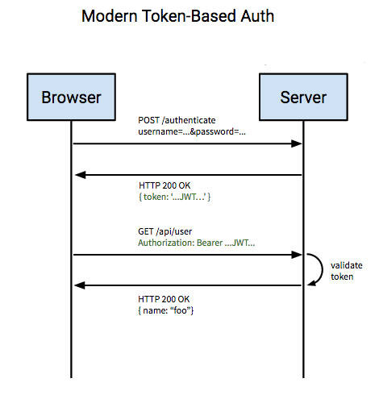
JWT Structure
Header :- The first part of a JWT that contains metadata about the token, such as the type (JWT) and the signing algorithm used.
Payload :- The second part that carries the claims or information. It includes predefined claims like issuer (iss), subject (sub), expiration time (exp), etc.
Signature :- The third part that ensures the integrity of the token. It is generated by combining the encoded header, payload, and a secret key and can be used to verify the token's authenticity.

Slide 18
JWT Usage
Generating JWT:
The code defines a JWT_SECRET, which is a secret key used for signing the JWT.
It uses the jwt.sign method to create a JWT token payload containing the user's email.
The JWT_SECRET is used to sign the token, generating the final token.
Responding to the Client:
If there are matching records in the database (result.length > 0), the code sends a JSON response indicating a successful login and includes the generated JWT token in the response.

Slide 19
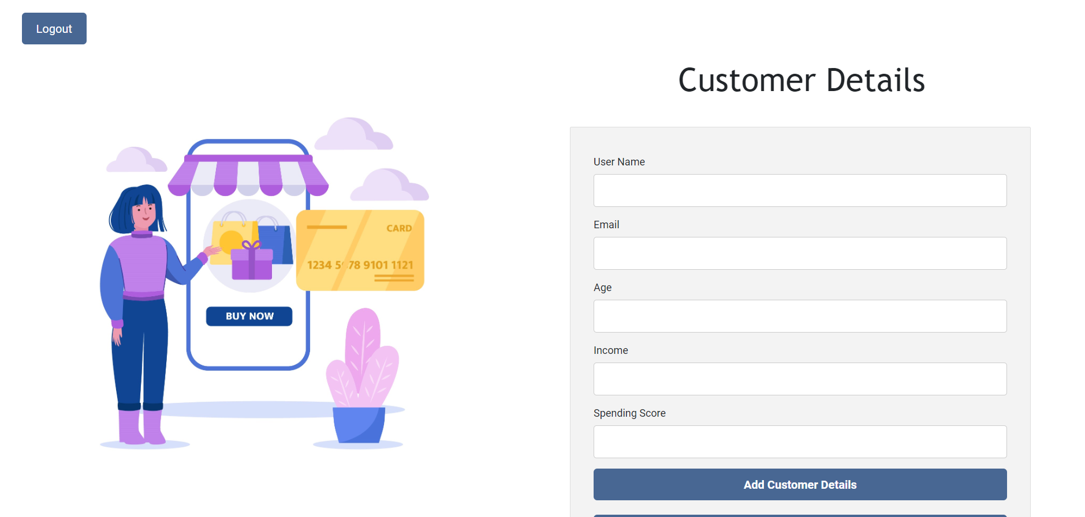
User Input

Slide 20
API Integration with Front-end
Api Connection :-
Here Axios which is javascript library is used
Axios.post() send the data as a request to Api and collect the response from Api
In back-End, the Flask Api collect data from front-end and pass to the model which perform prediction Operations and send Appropriate Response to Client
Response usage :-
The response collected (response.data) by client and the data is send to the PredictOutput Component as Props
By using JSX and CSS the prediction is represented

Slide 21
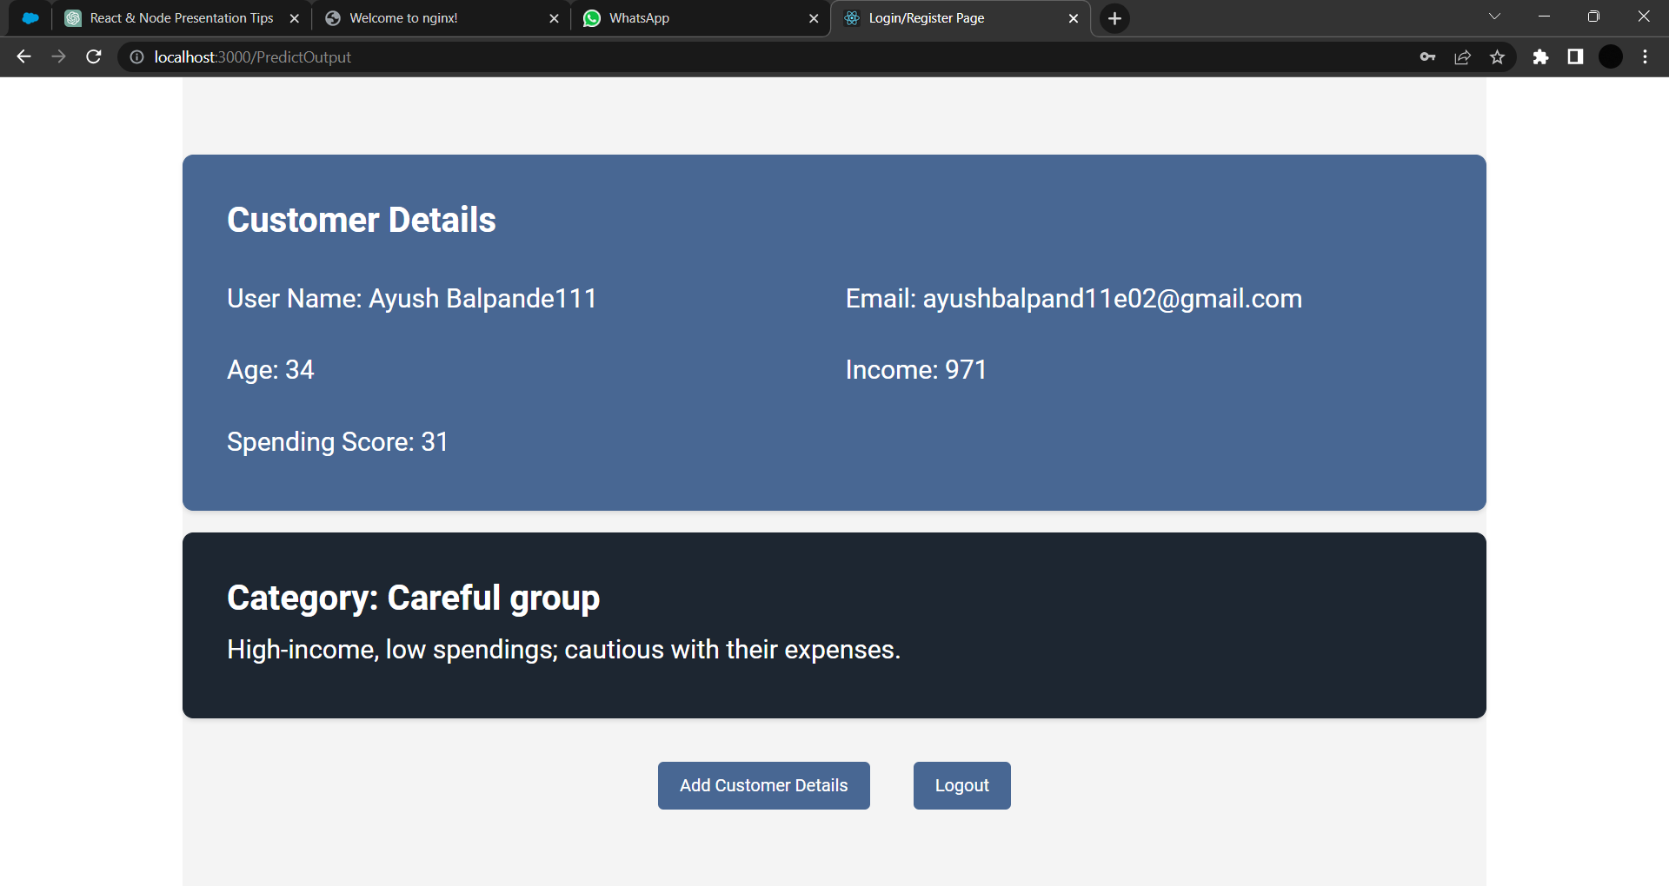
Prediction Output

Slide 22
Used Technology
ReactJs
Express.Js
Node.Js
Javascript
Cascading Style Sheet
JWT
CORS
MySQL
Nodemon
Bcrypt
Flask Api

Slide 23
Back-end overview:
Backend is implemented using Node.js and Express.js, interacting with a MySQL database. The server handles API endpoints for user registration, login, retrieving and deleting user data, and managing customer details.
Architecture:
The Express.js server is initialized using express() and creates a MySQL database connection pool using mysql.createPool().
Middleware such as body-parser and cors are used to parse request bodies and handle Cross-Origin Resource Sharing (CORS) respectively.
Body-parser is a middleware for Express.js that parses incoming request bodies in a middleware before your handlers, making it easier to extract data from the request body.

Slide 24
Back-end overview:
Technologies and Libraries:
Express.js is used as the web application framework.
The body-parser library is utilized to parse request bodies.
cors library is used for Cross-Origin Resource Sharing.
The bcrypt library is used for password hashing (with specified number of salt rounds) and comparison.
MySQL is used as the database system.
API Design:
The code defines various API endpoints using app.get(), app.post(), and app.delete() methods.
API endpoints are provided for user registration, login, retrieving and deleting user data, and managing customer details.
The endpoints interact with the MySQL database by executing SQL queries using db.query().

Slide 25
Back-end overview:
Database Interaction:
MySQL database connection is established using mysql.createPool() with the provided host, user, password, and database name.
SQL queries are executed using db.query() to retrieve, insert, or delete data from the database.
Authentication and Authorization:
The hashPassword() function uses bcrypt to hash passwords before storing them in the database.
The comparePassword() function compares the provided password with the hashed password stored in the database during login.
Error Handling and Logging:
Errors occurring during password hashing, password comparison, and database queries are logged to the console.
Error responses with appropriate HTTP status codes (500 for internal server error and 401 for authentication failure) are sent back to the client.

Slide 26
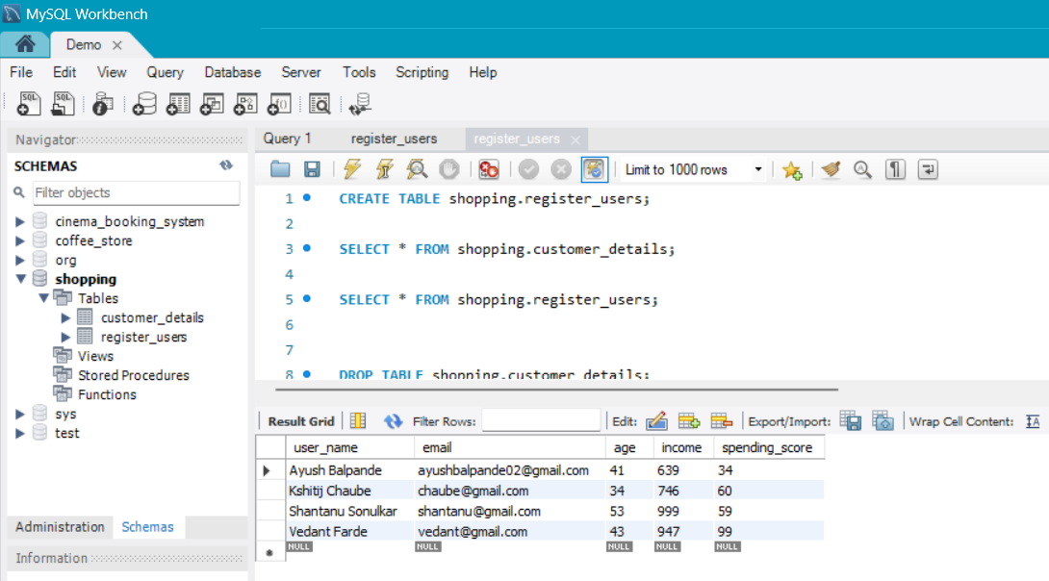
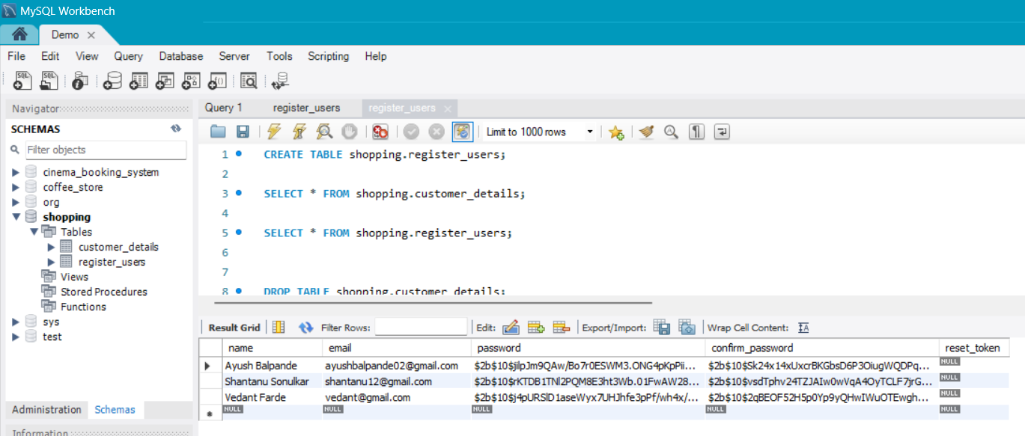
MySql workbench:

Slide 27
Communication between Back-end and Front-end:
Axios is a popular JavaScript library used for making HTTP requests from the browser or Node.js.
Axios provides several methods for making requests, such as axios.get(), axios.post(), axios.put(), and axios.delete(). Each method takes at least two arguments: the URL of the API endpoint and optionally the data to be sent with the request.
Axios returns a promise, allowing you to handle both successful responses and errors using .then() and .catch() respectively.
In the .then() block, you can access the response data returned by the server using the response.data property. You can then use this data to update the frontend state, display information to the user, or perform other actions as needed.
If an error occurs during the request (such as a network error, server error, or invalid request), the .catch() block will be executed. The error object can be accessed using the error parameter.

Slide 28
Session Handling:
Session handling is done successfully
We are using CORS and express-session and cookie-parser libraries for session handling.
We set the max-age value in the server code for how much time our session will be valid.
Once the time is up the site will automatically get redirected on the login page.

Slide 29
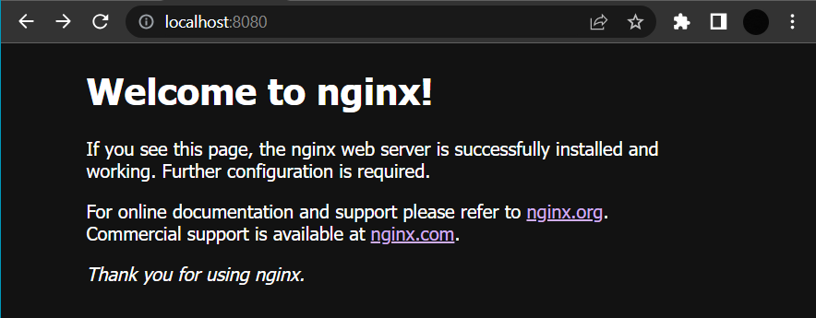
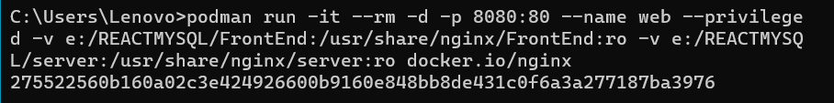
Containerization using Podman:
Install Podman and Podman desktop.
Setting up Podman:
podman machine init ---> machine set –rootful ---> podman machine start.
This command will create a secret key to your containerized image of your file:
podman run -it --rm -d -p 8080:80 –-name web -v /mnt/Podman/site- content:/usr/share/nginx/html docker.io/libary/nginx
After running this command you will get your react app on localhost:8080 (before that some configurations should be changed in nginx.conf file).

Slide 30
Business Use:
Customer Segmentation: The website can help the shopping mall understand its customers better by clustering them into distinct groups based on their spend score and demographics.
Store Layout and Product Placement: By analyzing the patterns and preferences of different customer segments, the website can assist the shopping mall in optimizing its store layout and product placement.
Marketing Campaigns and Offers: The website's insights can help the shopping mall in designing more effective marketing campaigns and promotional offers.
Customer Experience Enhancement: The website's analysis can contribute to improving the overall customer experience at the shopping mall.
Tenant Selection and Lease Management: The insights obtained from the website's analysis can aid the shopping mall in tenant selection and lease management.
Bank :- We can give are prediction to banks based on which they can decide whether to give loan or not to a particular customer

Slide 31
THANK YOU

